Slide 1

Spotify Hit Predictor
Predicting Track Popularity with XGBoost & AWS SageMaker
Çağla Akın
Imperial College Business School · Executive Education in Data Science
Imperial College Business School · 2026

Slide 2

Project Overview
Problem Statement
Solution
Artists and labels invest millions without knowing if a track will resonate.
Spotify paid $11B in royalties in 2025. Rates are set before release, creating overpayment risk when tracks underperform.
Can we predict popularity before release using only audio characteristics?
Predict popularity scores from audio features to enable smarter decisions:
XGBoost model trained on 170,000 Spotify tracks
Trained on AWS SageMaker, live demo on Streamlit Community Cloud
Finding: release year and artist history drive 97% of predictions
Spotify Hit Predictor | Capstone Project

Slide 3
The Dataset
SOURCE
Spotify API
Spotify case study dataset
SIZE
169,909 tracks
142,552 after removing zero-popularity entries
VARIABLES
15 features
audio features + 1 engineered feature (artist avg popularity)
YEARS
1921 – 2020
99 years of music; dataset skews toward post-2000 releases
Audio Features
SONIC ENERGY
Loudness · Energy · Tempo Danceability · Valence
MUSICAL CHARACTER
Acousticness · Instrumentalness Key · Mode · Liveness · Speechiness
METADATA + ENGINEERED
Duration · Explicit · Artist Avg Popularity (r=0.72, top engineered predictor)
Target: Spotify popularity score (0–100) based on stream count
Spotify Hit Predictor | Capstone Project

Slide 4
EDA: Three Data Quality Issues Shaped the Analysis
01
27,357 tracks had popularity = 0 (16.1% of raw data)
These are unlisted or unreleased catalogue entries, not genuine zero-stream tracks. All removed before modelling.
02
9,904 songs appeared as 21,473 separate entries
Same song, multiple Spotify IDs (original, remaster, anniversary edition). Popularity spread averaged 13.6 pts. All versions kept as each of them has a distinct popularity score.
03
Popularity is right-skewed and heavily modern-biased
Mean = 37.6, std = 18.1. Dataset skews toward post-2000 releases; older catalogue is sparse and scores lower, which partly explains the year correlation.
Spotify Hit Predictor | Capstone Project

Slide 5
EDA: Popularity is About Timing, Not Audio Features
Explicit Tracks Score 18.5 pts Higher
Key Takeaway: Year (r=0.82) is 2x stronger than the best audio feature (loudness, r=0.41). Audio features alone do not explain popularity. Timing and artist context matter more.
Spotify Hit Predictor | Capstone Project

Slide 6
Feature Engineering: artist_avg_popularity (r = 0.72)
01
Group by artist (training set only)
Pulled every track per artist from the training data and gathered their popularity scores.
02
Average the top 3 tracks per artist
Took the mean popularity of each artist's three best tracks. Using the top 3 (not all tracks) stops a single massive hit from skewing the whole picture.
03
Assign the value to every track by that artist
Every track from that artist inherits the same computed score as a new feature. Applied the same way across both train and test.
04
Fallback = 44.09 for unseen artists
Artists with no training history get the overall training mean. This prevents any data leakage from the test set into the feature.
Spotify Hit Predictor | Capstone Project

Slide 7
Pre-Processing Pipeline
STEP 1
Train / Test Split
114,041 training rows, 28,511 test rows. Split first before any feature engineering, all encoders and scalers are fit on training data only.
STEP 2
Feature Engineering
artist_avg_popularity computed on training data, then applied to the test set. Unseen artists fall back to the training mean (44.09).
STEP 3
Categorical Encoding
One-hot encoded musical key (12 keys to 11 binary columns, drop_first). Flagged explicit tracks as binary 0/1. Dropped id, name, release_date, decade.
STEP 4
StandardScaler
Scaled all numeric features to mean=0, std=1. Fit on X_train, applied to both sets. Final feature matrix: 25 features.
Spotify Hit Predictor | Capstone Project

Slide 8
Model Comparison: XGBoost Generalises Best
MODEL TRAIN RMSE TEST RMSE TEST R² OVERFIT GAP
Dummy Baseline 18.08 18.17 0.00 0.09 pts
Linear Regression 9.49 10.02 0.70 0.53 pts
Random Forest 3.39 9.77 0.71 6.38 pts
XGBoost default [best] 8.03 9.65 0.72 1.62 pts
XGBoost tuned 8.00 9.72 0.71 1.72 pts
Random Forest overfit: Train RMSE 3.39 vs Test RMSE 9.77 is a 6.38-pt gap, implying the trees memorized noise instead of pattern learning.
Why XGBoost wins: The train/test gap to just 1.62 pts, with the best R² (0.72). Tuning did not improve the outcome (see next slide for details).
Spotify Hit Predictor | Capstone Project

Slide 9
Hyperparameter Tuning: Default Parameters Won
RandomizedSearchCV is run to check whether custom hyperparameters could beat the defaults. Here is what happened:
SEARCH SPACE
6 hyperparameters
n_estimators, max_depth, learning_rate, subsample, colsample_bytree, min_child_weight
METHOD
50 iterations, 3-fold CV
150 model fits total. Best CV params: n_estimators=300, max_depth=7, lr=0.05, subsample=0.9
RESULT
CV RMSE 8.74
Test RMSE 9.72
Overfit to CV folds. Tuned model worse than default on unseen data.
Conclusion: XGBoost default parameters (n_estimators=100, max_depth=6, lr=0.3) were already near-optimal for this dataset. Hence default parameters are selected as the final model.
CV RMSE Test RMSE Gap
XGBoost default [SELECTED] n/a 9.65 —
XGBoost tuned 8.74 9.72 overfit to CV folds
Spotify Hit Predictor | Capstone Project

Slide 10
The Model: XGBoost
WHAT IS XGBOOST?
XGBoost builds an ensemble of decision trees one at a time. Each new tree focuses on correcting the mistakes of the previous ones. This sequential process makes it accurate and resistant to overfitting.
WHY XGBoost FOR THIS PROJECT?
It beat both Linear Regression and Random Forest on test RMSE while keeping the smallest train/test gap. It also integrates natively with AWS SageMaker, which was the deployment target.
0.72
R² (test set)
9.65
RMSE (test set)
DEFAULT PARAMETERS (FINAL MODEL)
n_estimators = 100 Number of trees in the ensemble
max_depth = 6 Max decision splits per tree
learning_rate = 0.3 How much each tree corrects the previous
subsample = 1.0 Fraction of training rows per tree
colsample_bytree = 1.0 Fraction of features per tree
objective = reg:squarederror Predict continuous score 0-100
Spotify Hit Predictor | Capstone Project

Slide 11
Feature Importance: Year and Artist History Dominate
97%
of predictive power from
year + artist history
<3%
combined weight from
all audio features combined
Audio quality is largely irrelevant to Spotify popularity. What matters is when you release and who you are.
Spotify Hit Predictor | Capstone Project

Slide 12
Key Findings: What Actually Drives Popularity
r=0.82
Year
Release year is the top predictor by far – about 2x stronger than the best audio signal. This is structural: Spotify's algorithm weights recent streams more heavily, so newer tracks score higher regardless of quality.
r=0.72
Artist Reputation
Artist average popularity is the most actionable metric you can compute before signing. It is calculable from public Spotify data and gives a direct read on royalty risk.
r=0.41
Loudness
Loudness and danceability show positive correlations, but once year and artist context are included, XGBoost assigns them less than 3% combined weight. Strong raw correlation, weak independent predictor.
r=-0.47
Acousticness
Acoustic tracks score lower globally, but this reflects dataset composition. Acoustic genre artists simply underperform on the global Spotify chart relative to their within genre standing.
97%
Model Weight
Year and artist history account for 97% of what XGBoost learns. Tempo, energy, valence are essentially irrelevant once context is included.
<3%
Audio Features
Sound profile does not drive Spotify popularity. The implication: producing a “better-sounding” song is not a reliable lever for commercial streaming performance.
Spotify Hit Predictor | Capstone Project

Slide 13
Business Implications: Three Decisions This Model Informs
01 Low avg_popularity + premium rate = high financial risk
artist_avg_popularity is publicly calculable from Spotify data before any contract is signed. Artists below 30 average popularity carry structurally high royalty-to-stream cost risk. Make this a standard pre-contract filter.
02 The missing variable: marketing
The model explains 72% of popularity variance using only timing and artist history. The remaining variance is not random: it is driven by editorial playlist placement, social campaigns, sync deals, and label investment. Marketing spend effectiveness should be quantified before any major signing decision.
03 Spotify can shape its own cost base
If Spotify's own editorial curation drives a material share of the popularity score, it can boost lower-premium artists through targeted promotion. That reduces royalty cost per stream while keeping listeners engaged, which is a profitable incentive.
Spotify Hit Predictor | Capstone Project

Slide 14
Limitations
Genre data absent
Popularity is context-dependent. Norah Jones scores low globally but ranks highly within adult contemporary. A global model conflates “low streaming” with “low quality” — these are not the same thing.
Spotify embeds its own marketing
The popularity score reflects streams partly driven by editorial playlists and algorithmic promotion. The model cannot separate organic popularity from platform amplified popularity.
Static 2021 snapshot
Popularity scores decay as attention shifts to newer releases. The model systematically underestimates tracks that gained streams after 2021 and overestimates older catalogue whose rates have since dropped.
Spotify-only measure
A track viral on TikTok, YouTube, or Apple Music may show low Spotify popularity. The model cannot generalise to overall commercial success, can do only to Spotify-specific streaming at one point in time.
Spotify Hit Predictor | Capstone Project

Slide 15
AWS Deployment Architecture
Training Data
Amazon S3
SageMaker
Training
SageMaker
Endpoint
Streamlit App
Spotify CSV
142,552 tracks
Train / Validate
/ Test splits
XGBoost container
ml.m5.xlarge
Real-time inference
Live predictions (Streamlit Cloud)
S3 Bucket
Training Job
Endpoint
Stores train/ validate/test/ splits, read directly by SageMaker during training
Manages instance spins up, trains model, saves the artifact back to S3 automatically
App sends audio features, receives a predicted popularity score (0–100) in milliseconds
Spotify Hit Predictor | Capstone Project

Slide 16
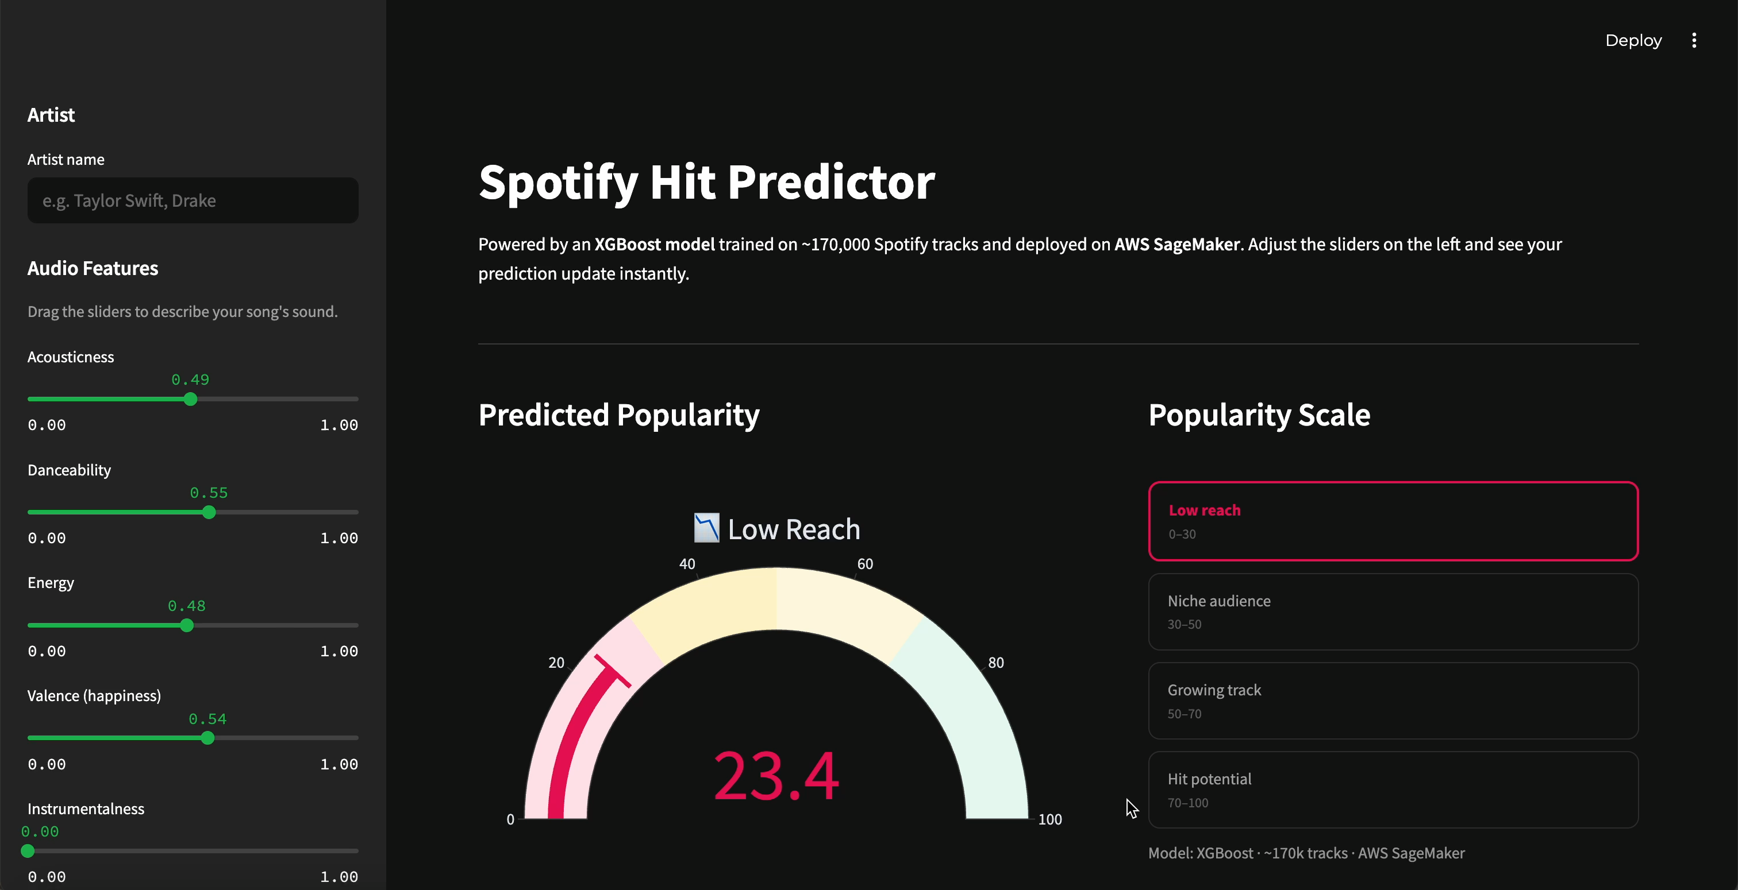
▶ LIVE DEMO
Spotify Hit Predictor: Streamlit App
[ Switch to browser to show the live app ]
1
Search an artist
2
Adjust audio sliders
3
See predicted popularity score
Spotify Hit Predictor | Capstone Project

Slide 17
Appendix
REF
RESOURCE
A
GitHub Repository
B
Data Source
C
Jupyter Notebook
D
Case Study
E
Streamlit App
F
Project Report: What Makes a Song Popular?
Spotify Hit Predictor | Capstone Project

